Slide 1
SYSTEM DESIGN
CHAPTER 7 Linkers and Loaders
Developed By:
Vivek Vyas
Department of MCA
DDU

Slide 2
Introduction
Execution of a program involves:
Translation of the program – performed by a translator
Linking of the program with other programs needed for its execution – performed by linker
Relocation to execute from the specific memory area allocated – performed by linker
Loading of program in the memory for the purpose of execution – performed by loader

Slide 3
Introduction
Data
Binary
program
Translator
Linker
Loader
------->
Source
Program
Result
Object modules
Binary Programs

Slide 4
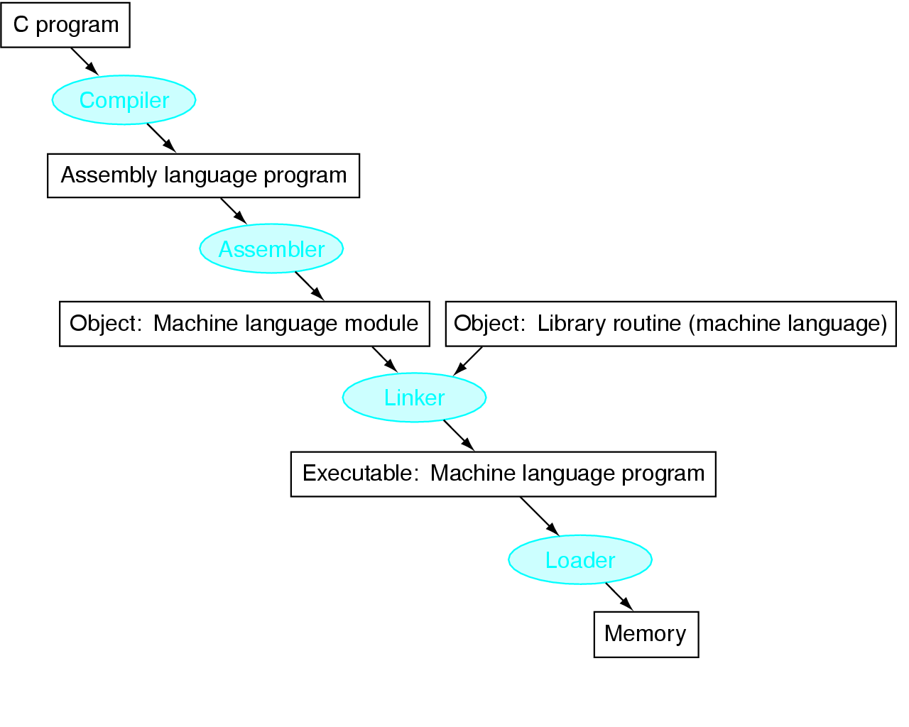
Introduction
Translation Hierarchy

Slide 5
Introduction
Compiler converts a single HLL file into a single assembly language file.
Assembler removes pseudo, converts it can to machine language. This changes each .s file into a .o file.
Linker combines several .o files and resolves absolute addresses.
Loader loads executable into memory and begins execution.

Slide 6
Introduction
When program is translated, origin is specified to translator called translated origin.
eg: START and ORIGIN specifies the origin in asssembly languages.
Translator origin is used to perform memory allocation for the symbols declared in P.
Assigns translation time address t_{symb} to each symbol in the program.
Execution start address – address of instruction from which execution must begin

Slide 7
Introduction
Translation start address – address specified by translator.
The origin of a program may have to be changed by linker or loader due to two reasons.
i) library routines have same translated origin so memory allocation to such programs would conflict unless their origins are changed.
ii) OS may require that a program should execute from a specific area of memory.
Change of origin leads to changes in the execution start address and in the addresses assigned to symbols.

Slide 8
Introduction
Translation time(translated) address - address assigned by the translator.
Linked address – address assigned by the linker.
Load time(load) address – address assigned by the loader.
Translated origin – Address of the origin assumed by translator or address specified by the programmer in an ORIGIN statement.
Linked origin – Address of the origin assigned by the linker while producing a binary program.
Load origin – address of the origin assigned by loader while loading the program for execution.

Slide 9
Introduction
Program Unit P:
START 500
ENTRY TOTAL
EXTRN MAX, ALPHA
READ A 500) + 09 0 540
LOOP 501)
:
MOVER AREG, ALPHA 518) + 04 1 000
BC ANY, MAX 519) + 06 6 000
:
BC LT, LOOP 538) + 06 1 501
STOP 539) + 00 0 000
A DS 1 540)
TOTAL DS 1 541)
END

Slide 10
Introduction
Eg-1: Translated origin =500
address of LOOP = 501
- If the program is loaded for execution in memory with starting address = 900. so, load time origin=900.
- hence, load time address of LOOP = 901.

Slide 11
7.1 Relocation and Linking concepts
Program Relocation
Program P assumes its instructions and data to occupy memory words with specific addresses. Such a program is called address sensitive program.
address sensitive instruction: an instruction having absolute addresses
address constant: word which contains an absolute address.
If address is changed then address of sensitive instruction must be changed.

Slide 12
7.1 Relocation and Linking concepts
Program Relocation: is a process of modifying the addresses used in the address sensitive instructions of a program such that the program can execute correctly from the designated area of memory.
If linked origin!= translated origin, relocation must be performed by the linker.
If load origin!= linked origin, relocation must be performed by the loader.

Slide 13
7.1 Relocation and Linking concepts
Eg-2: Translated origin =500
translated time address of symbol A = 540
READ A (address sensitive instruction)
- If linked origin = 900
- A would have link time address = 940
- address in READ instruction = 940

Slide 14
7.1 Relocation and Linking concepts
Performing relocation
Let the translated and linked origins of program P be t_origin_{p} and l_origin_{p} respectively.
Consider a symbol symb in P. lets its translation time address t_{symb} and link time address be l_{symb.}
relocation_factor_{p} = l_origin_{p} – t_origin_{p}

Slide 15
7.1 Relocation and Linking concepts
t_{symb} = t_origin_{p} + d_{symb}
where d_{symb} is the offset of symb in P.
l_{symb} = l_origin_{p} + d_{symb}
Eg: Translated origin =500
linked origin = 900
relocation_factor = 900 -500 = 400

Slide 16
7.1 Relocation and Linking concepts
instruction with translated addresses 500 and 538 contains the address 540 and 501 in the operand field.
so, link time address of symbol A is changed to (540+400) = 940
address is changed to (501+400) =901

Slide 17
7.1 Relocation and Linking concepts
Linking
program is divided into units which interacts.
Public definition – symbol defined in one unit and can be referenced in other unit.
External reference – symbol used in the unit which is not defined in the unit.
ENTRY – list public definition
EXTRN – symbols to which external reference is made

Slide 18
7.1 Relocation and Linking concepts
Public definition of TOTAL exists
External references to MAX and ALPHA exists
assembler doesn’t know the address of an external symbol hence 000 is placed in instruction MOVER AREG,ALPHA and BC ANY, MAX.
If EXTRN statement did not exist, assembler would give errors.
Linking: is the process of binding an external reference to the correct link time address.

Slide 19
7.1 Relocation and Linking concepts
Resolving External Reference
Program Unit Q:
START 200
ENTRY ALPHA
:
ALPHA DS 25 231) + 00 0 025
END

Slide 20
7.1 Relocation and Linking concepts
Eg: Program unit P linked with the program unit Q
Program unit P contains an external reference to symbol ALPHA i.e public definition in Q with translation time address 231.
Link origin of P=900 and Size =42 words
Link origin of Q= 942, link time address of ALPHA =973
Putting the address 973 in the instruction with the translation time address 518 in P.

